Slide 1
Linked Data Workshop - Installations Instructions
Jad El-khoury
jad@kth.se

Slide 2
Installation - JIRA server
Download and install JIRA server
https://www.atlassian.com/software/jira/download
Test: Can you create a Jira Issue?
Notes:
Aim to have a standalone setup on your computer.

Slide 3
Installation - Apache Jena Fuseki
Download Apache Jena Fuseki
https://jena.apache.org/download/index.cgi
Install Fuseki
Unzip binary to a suitable location
Run Fuseki
Start a cmd prompt and execute <path_to_fuseki>\apache-jena-fuseki-2.5.0\fuseki-server.bat
Browse to http://localhost:3030
Test: Can you see something?
Notes:
Aim to have a standalone setup on your computer.

Slide 4
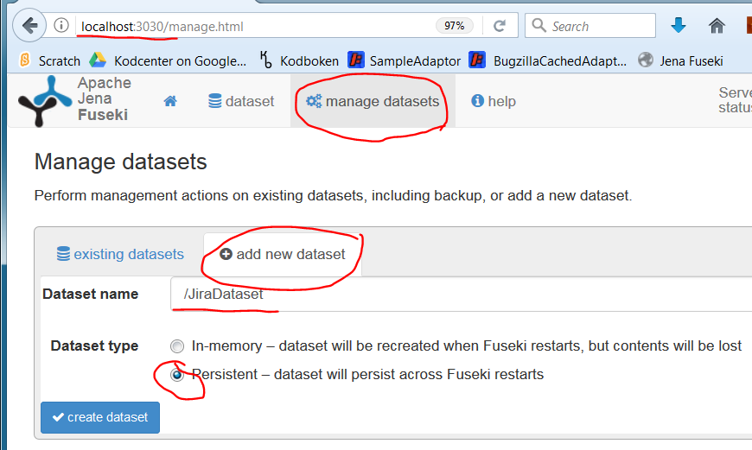
Installation - Apache Jena Fuseki
Select ”manage datasets” from the top menu
select ”add new dataset”, with the following properties
Dataset name: ” /JiraDataset”
Dataset type: “Persistent”
Press “Create dataset”
Notes:
Aim to have a standalone setup on your computer.

Slide 5
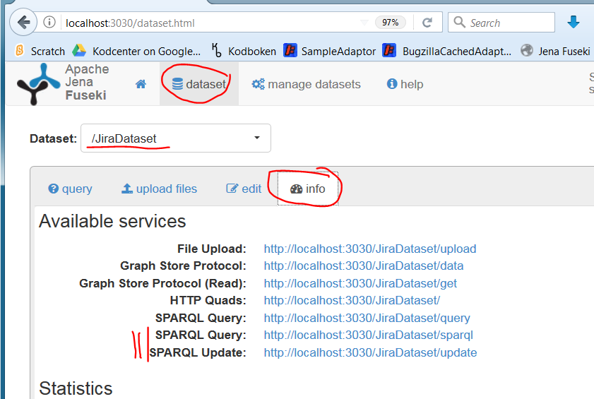
Installation - Apache Jena Fuseki
Select ”dataset” from the top menu
Select the newly created ”/JiraDataset” Dataset
Select ”info” and record the value of
SPARQL Query (http://localhost:3030/JiraDataset/query)
SPARQL Update (http://localhost:3030/JiraDataset/update)
Notes:
Aim to have a standalone setup on your computer.

Slide 6
Installation - Eclipse IDE
Install the Eclipse IDE as instructed under
https://wiki.eclipse.org/Lyo/General_Setup_for_OSLC4J_Development
You need to first install a Java JDK 8
Recommend using “Eclipse IDE for Java EE developers”
Recommend using Eclipse Oxygen

Slide 7
Installation - Lyo Designer Plugin
Install the 2 Lyo Plugins as instructed under
https://wiki.eclipse.org/Lyo/modelling_and_generation/installation

